Slide 1
Medical Notes NLP Challenge

Slide 2
Problem Statement
Need to suggest best tokenization/Embedding techniques for given set of data
Data Sets given:
Clinical Notes for Cardio, Neurology and Gastroenterology
Another set of Related keywords used in Medical field
Methodologies Followed
Word Cloud visualization
TSNE Visualization
Sentence Vectorization – Cosine Similarity & HeatMap
Word Vectorization - Cosine Similarity for Clinical Terms
Supervised Learning Approcah

Slide 3
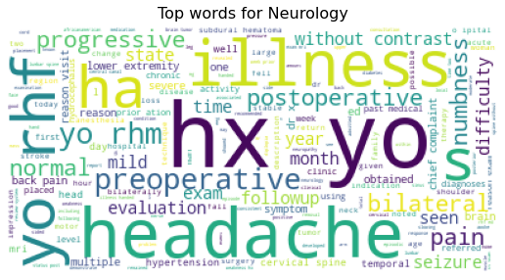
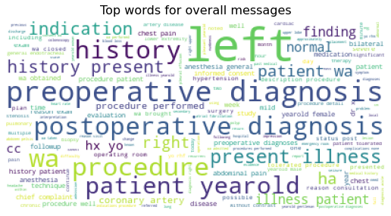
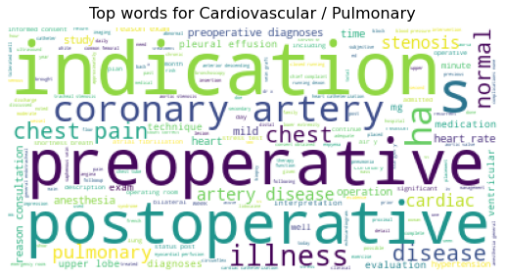
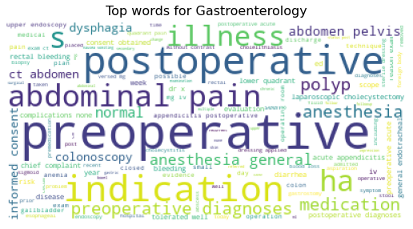
EDA - Word Cloud visualization
Cat1: Cardiovascular/Pulmonary - 371
Cat2: Neurology -223
Cat3: Gastroenterology- 224
Total Number of Sentences in Clinical Notes column: 21727
Total Number of unique words in transcriptions column: 20091
Some common words used across all categories are
history
Patient
Normal
Yearold
Diagnosis
Procedure
Performed etc.

Slide 4
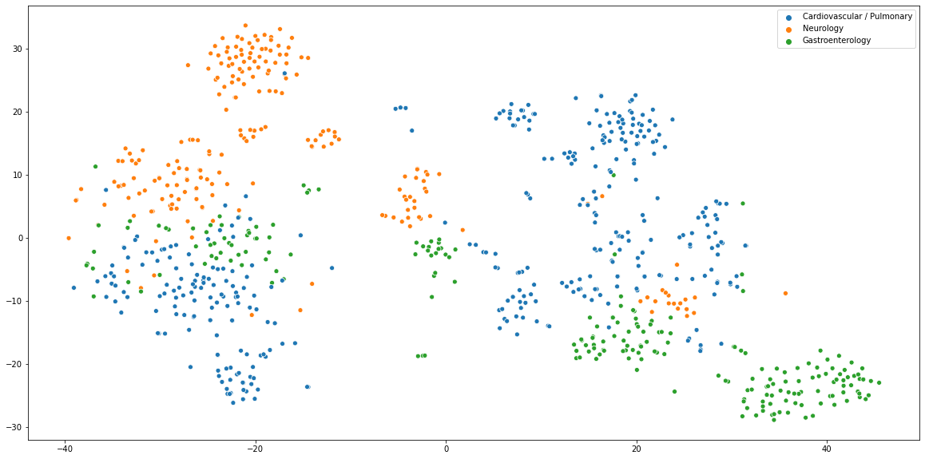
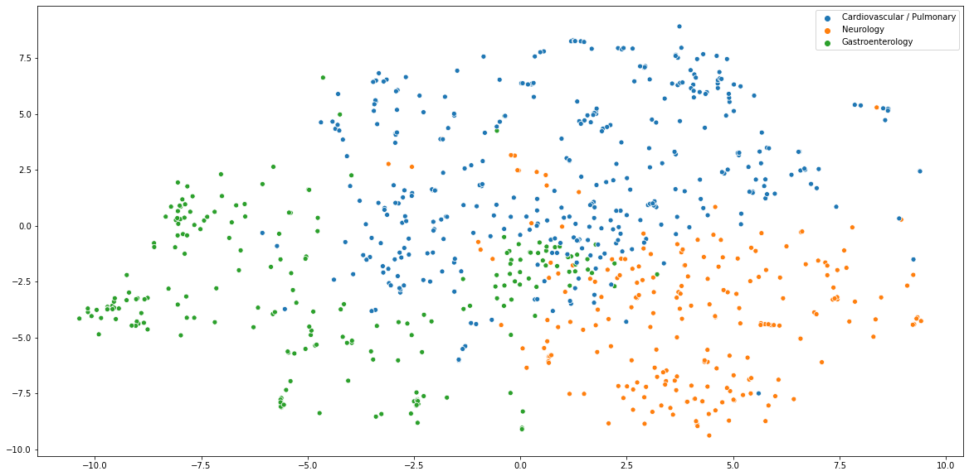
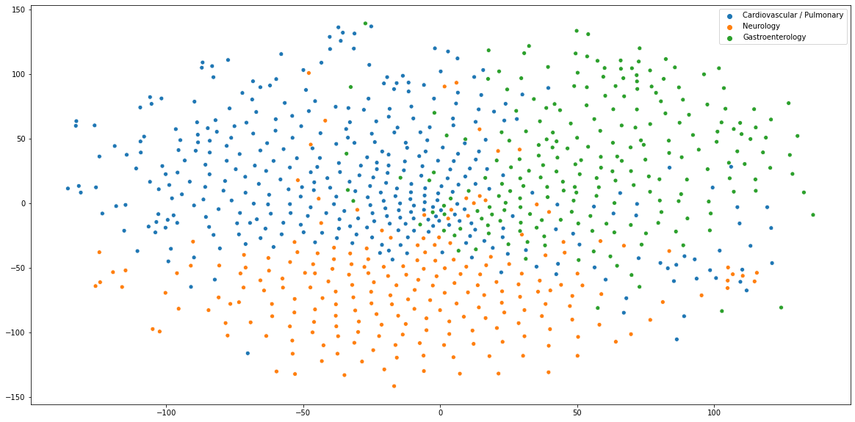
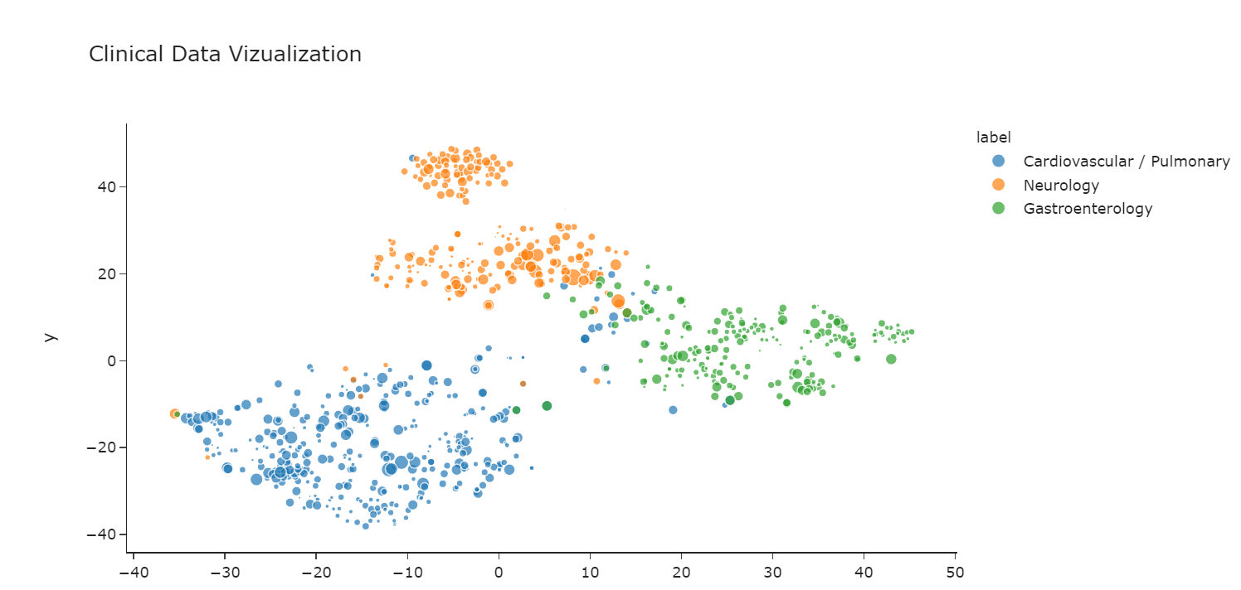
TSNE Visualization
TF-IDF Vectorization
en_ner_bionlp13cg_md SPACY Model
en_ner_bc5cdr_md SPACY Model
bert_en_uncased_L-12_H-768_A-12 Model

Slide 5
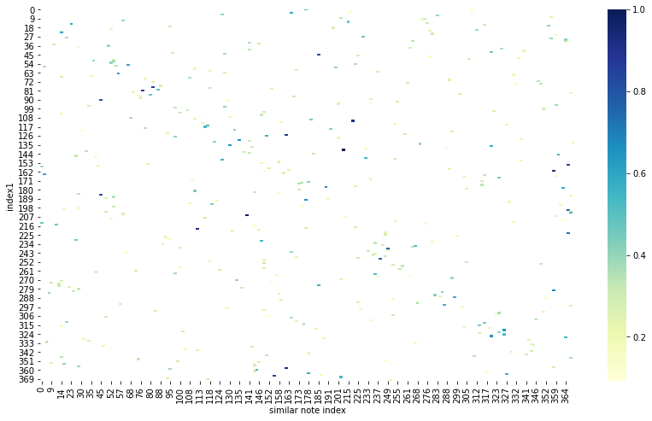
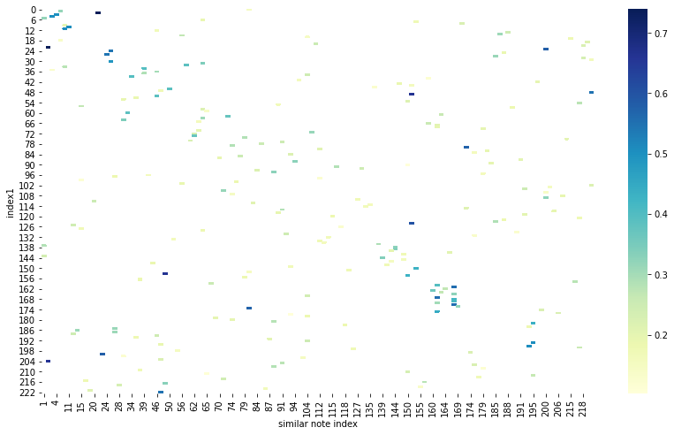
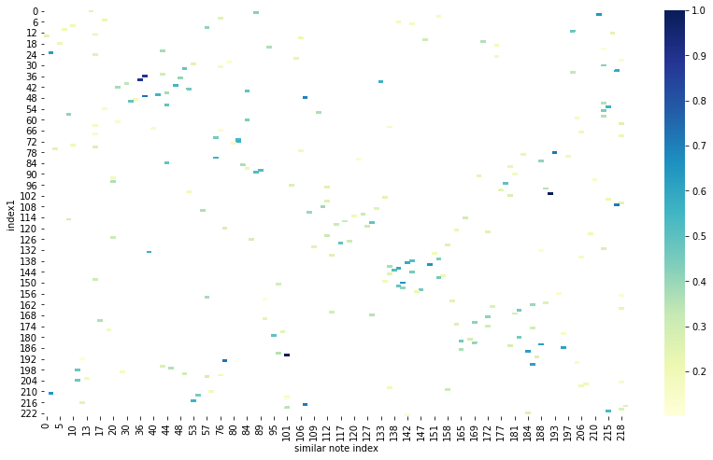
Cosine Similarity Heat Map – TD-IDF Vectorization
Cardio
Neuro
Gastroenterology
Mean Cosine Similarity Score
for Cardio Notes
using TFIDF : 0.3360795148247978
Mean Cosine Similarity Score
for Neuro Notes
using TFIDF : 0.2675627802690583
Mean Cosine Similarity Score
for Gastroenterology Notes
using TFIDF : 0.34293839285714284

Slide 6
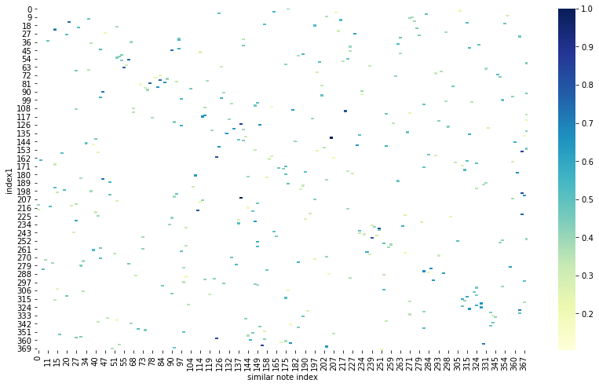
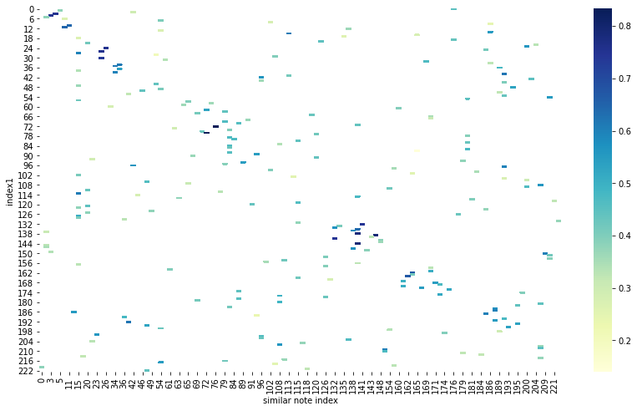
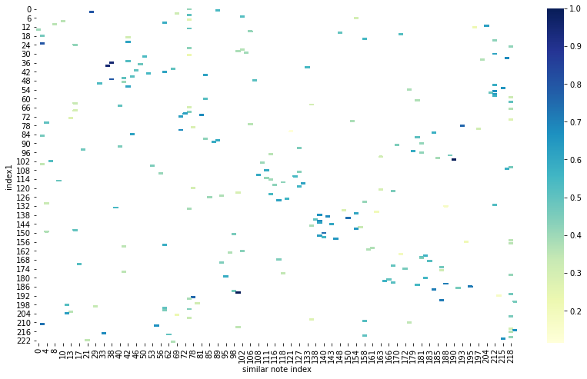
Cosine Similarity Heat Map – Count Vectorizer
Cardio
Neuro
Gastroenterology
Mean Cosine Similarity Score
for Cardio Notes using Count Vectorizer : 0.4464140161725068
Mean Cosine Similarity Score
for Neuro Notes using
Count Vectorizer : 0.3822856502242152
Mean Cosine Similarity Score
for Gastroenterology Notes using
Count Vectorizer : 0.482534375

Slide 7
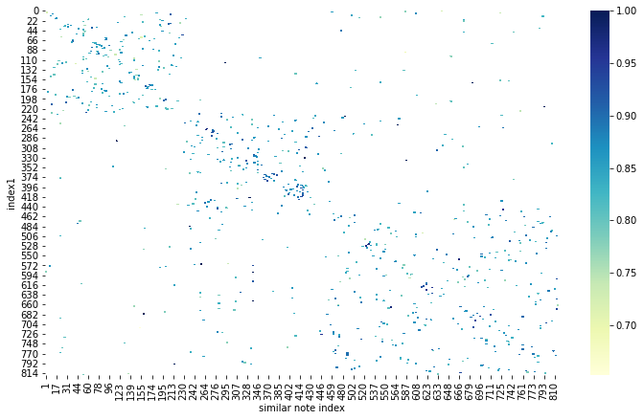
Cosine Similarity Heat Map – BERT
Average Cosine Similarity for Medical Word Terms Given
Using en_ner_bionlp13cg_md : 0.264706
Using en_ner_bc5cdr_md : 0.264706
Using Bert–large-uncased : 0.627902
Mean Cosine Similarity Score for Bert Model 0.8481940097799511

Slide 8
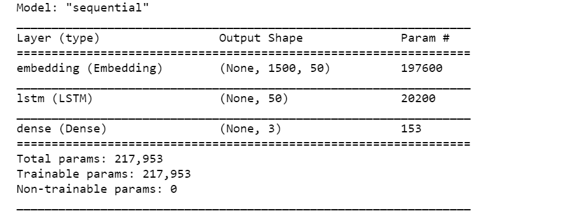
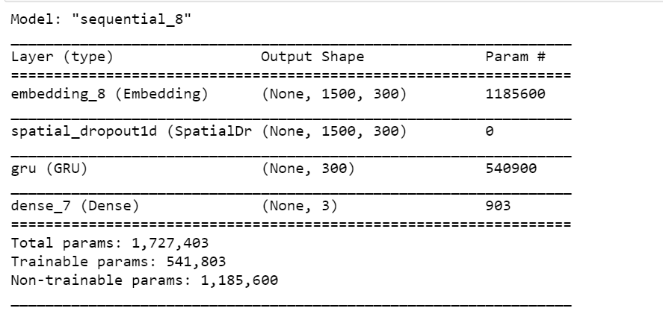
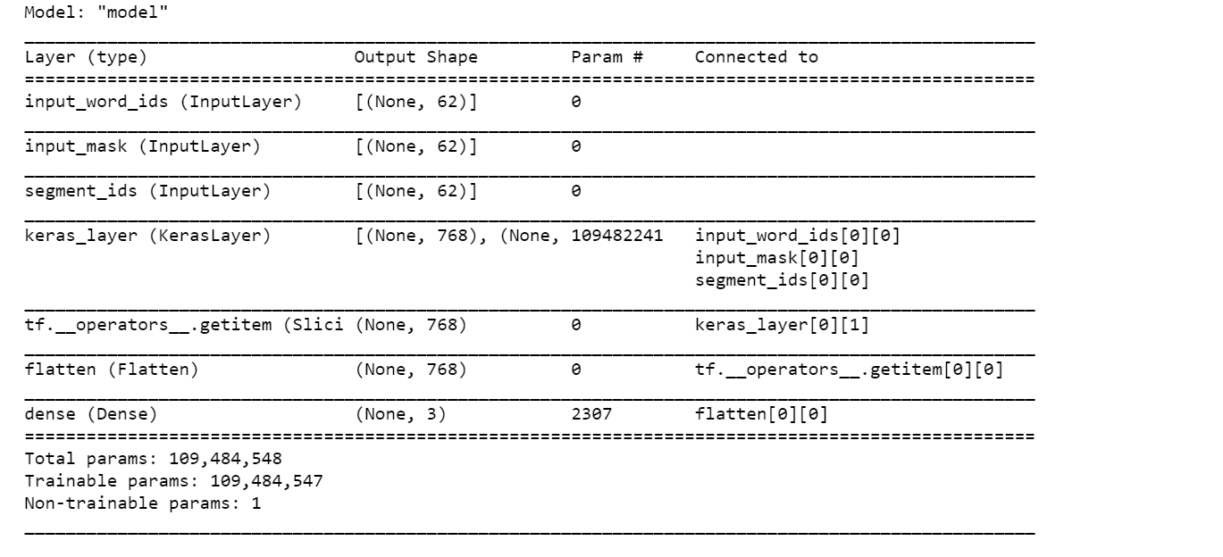
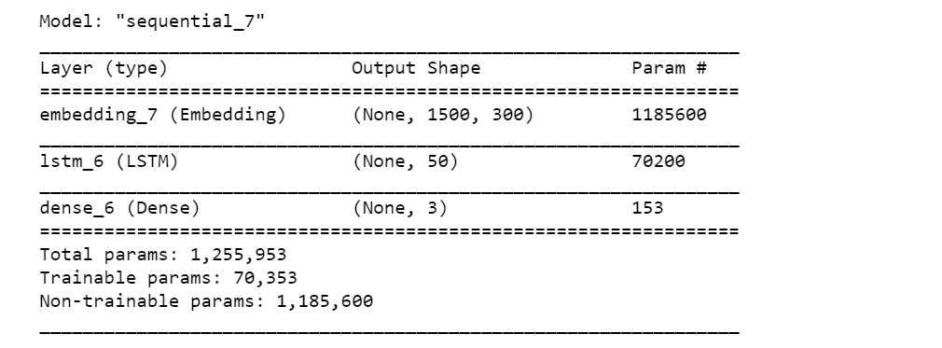
Supervised Learning Method Approcah
LSTM without any pretrained embeddings
(Keras Layer Embedding) and one dense layer
GRU with GLOVE pretrained embeddings and one dense layer
Train Accuracy 0.8724
Test Accuracy 0.6423
Train Accuracy 0.8357
Test Accuracy 0.6951
LSTM with GLOVE pretrained embeddings and one dense layer
BERT Pretrained Embeddings with Dense Layer
Train Accuracy 0.7762
Test Accuracy 0.6098
Accuracy Above 0.9

Slide 9
Observations:
Based on TSNE visualization, Medical terms Trained SPACY model is doing good than TFIDF. However Bert model outperforming both TFIDF & Spacy.
Based on Sentence Vectorization & Cosine Similarity estimation, Count Vectorizer technique gave good score than TFDIF. Bert_en_uncased is way better than previous two.
As for as Word Vectorization is concerned, Pretrained Bert Model give good result than Domain trained SPACY models.
All Supervised Learning methods (LSTM, GRU, BERT) are giving good accuracies for given dataset.
Overall, Bert_en_uncased is winner in Most of the areas. It can be used further research for best results.
Semantic Embeddings, static & Dynamic embeddings are being outperformed by Transformer Architecture based Model.
Further Study can be done to choose best transformer architecture models

Slide 10
THANK YOU

